Slide 1


HOMEHIVE
DBMS PROJECT GROUP 06
Team Members:
AHANYA MARIAM POKKAMTHANAM, 2241107
ANTONY CHANDY DOUGLAS, 2241117
RUCHIT DHANUKA, 2241150
Under the Guidance of:
Dr.Sagaya Aurelia
MISSION
CHRIST is a nurturing ground for an individual’s holistic development to make effective contribution to the society in a dynamic environment
VISION
Excellence and Service
CORE VALUES
Faith in God | Moral Uprightness
Love of Fellow Beings
Social Responsibility | Pursuit of Excellence

Slide 2
CHRIST
Deemed to be University
CONTENT
1.ABOUT HOMEHIVE
2.EXISTING SYSTEM & LIMITATIONS
3.KEY FEATURES
4.OBJECTIVES
5.REQUIREMENT ANALYSIS
6.DATA FLOW DIAGRAM
7.FUNCTIONALITY
8.UI MODULES
Admin Login
User Login
Home Page
Categories
Sub Categories
Profile
Cart
Order
9.DATABASE
Database Schema
ER Diagram
Excellence and Service

Slide 3
CHRIST
Deemed to be University
HOMEHIVE
HomeHive is an innovative online marketplace for household products.
Combines traditional e-commerce features with cutting-edge functionalities.
Prioritizes delivering an unparalleled shopping experience.
Blends familiarity with uniqueness, setting it apart from traditional platforms.
Excellence and Service

Slide 4
CHRIST
Deemed to be University
EXISTING SYSTEM
Wayfair:
Online retailer for furniture, home decor, and household goods.
Wide product range for various styles and budgets.
Bed Bath & Beyond:
Both online and physical stores.
Specializes in home goods like bedding, kitchenware, and decor.
Amazon Home:
Part of Amazon marketplace.
Extensive selection of home goods, including furniture and appliances.
LIMITATIONS
Cryptocurrency Integration:
Technical complexity due to diverse APIs and security concerns.
Compliance challenges with evolving regulations.
Shared Cart:
Users can collaborate by sharing shopping carts, perfect for families, roommates, or groups planning purchases together.
Excellence and Service

Slide 5


CHRIST
Deemed to be University
KEY FEATURES
Cryptocurrency Payments:
HomeHive introduces cryptocurrency payments.
Allows secure and decentralized transactions.
Shared Carts:
Simplifies shopping with shared carts.
Enables collaborative curation for families or groups.
Excellence and Service

Slide 6
CHRIST
Deemed to be University
OBJECTIVE
To provide a user-centric interface, focusing on ease of navigation and a personalized shopping journey.
To provide a platform that is home to a vast array of products across multiple categories, catering to a wide range of consumer needs and preferences.
To develop distinguishing features include cryptocurrency payment integration, shared carts allowing collaborative shopping experiences.
Excellence and Service

Slide 7
CHRIST
Deemed to be University
REQUIREMENT ANALYSIS
HARDWARE REQUIREMENTS
OS: Windows 10 or above
Processor: Core 2 Duo
Memory: 4 GB RAM
Storage: 1 GB available space
SOFTWARE REQUIREMENTS
Operating System: Windows 7 or later
Front End: HTML /CSS / JavaScript
Back End: MySQL/Node.js
NETWORK REQUIREMENTS
Network: Google Chrome / Mozilla/ Brave or equivalent
WIFI: Internet Required.
Excellence and Service

Slide 8
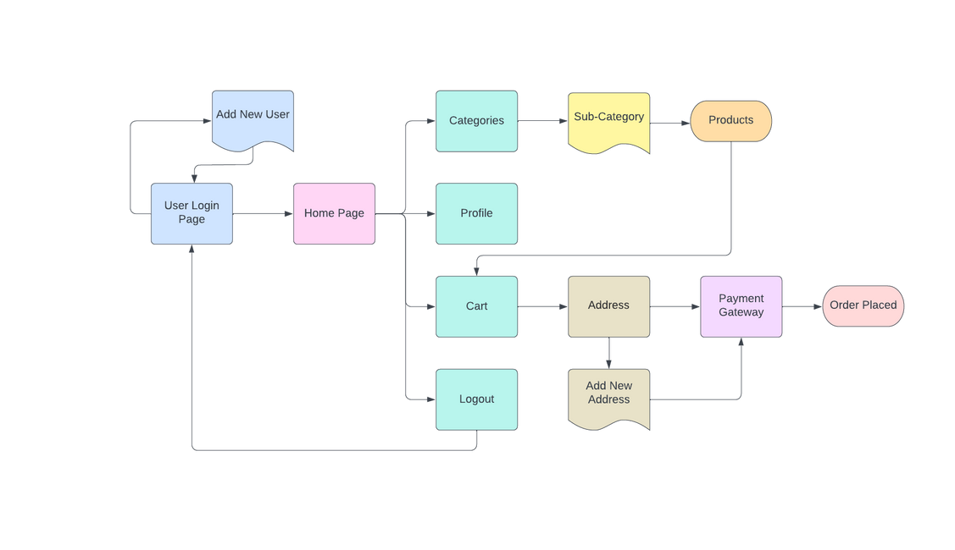
CHRIST
Deemed to be University
DATA FLOW DIAGRAM
Excellence and Service

Slide 9
CHRIST
Deemed to be University
FUNCTIONALITY
User Management
Roles and Permissions
Product Management
Search and Filter
Shopping Cart
Checkout Process
Order Management
Communication
Excellence and Service

Slide 10
CHRIST
Deemed to be University
USER AUTHENTICATION AND MANAGEMENT
Excellence and Service

Slide 11
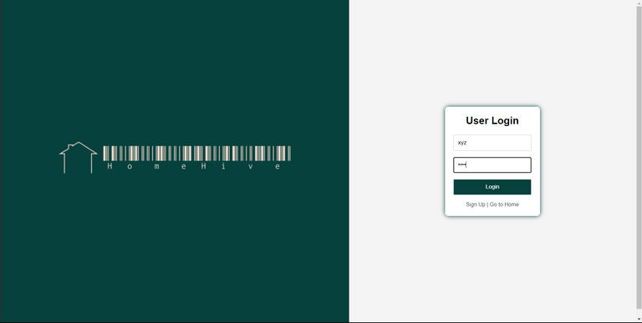
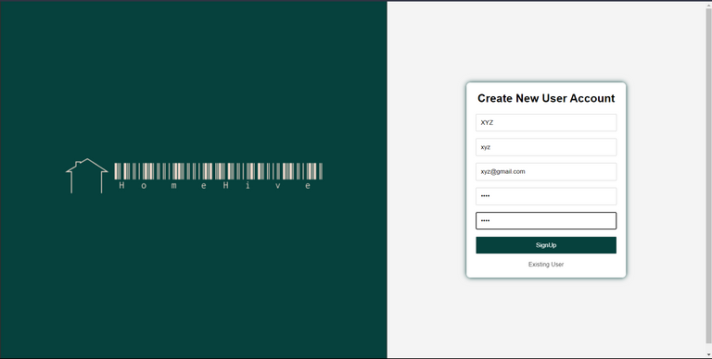
CHRIST
Deemed to be University
USER LOGIN
EXISTING USER LOGIN
Login through username and password.
Option to Create new account
CREATE NEW USER ACCOUNT
Create Username,
Add email
Create password
Password confirmation
Excellence and Service

Slide 12
CHRIST
Deemed to be University
ADMIN PANEL
Excellence and Service

Slide 13

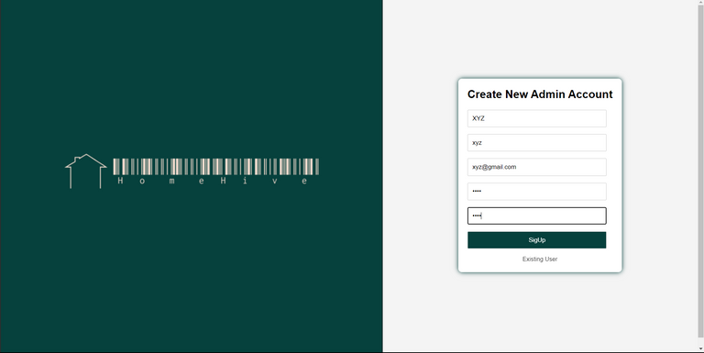
CHRIST
Deemed to be University
ADMIN LOGIN
EXISTING ADMIN LOGIN
CREATE NEW ADMIN ACCOUNT
Login using username and password
Option to Create new Account
Create Username,
Add email
Create password
Password confirmation
Excellence and Service

Slide 14
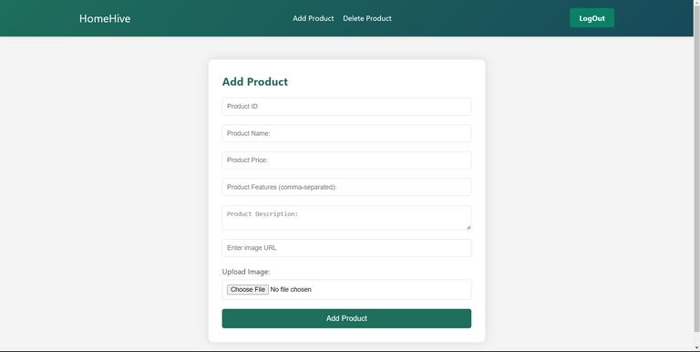
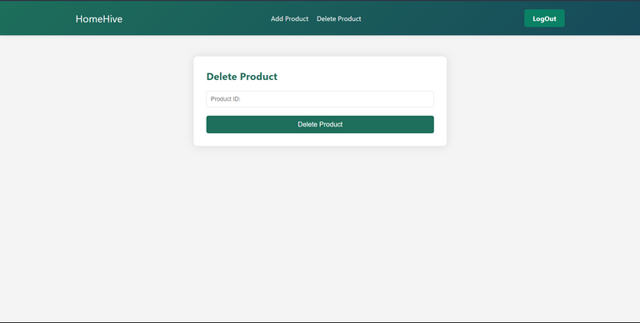
CHRIST
Deemed to be University
ADD PRODUCT AND DELETE PRODUCT
Add/Delete product page
Accesible by the Admin after login
ADD PRODUCT:
DELETE PRODUCT:
ID,
NAME,
FEATURES,
DESCRIPTION
IMAGE URL
Only ProductID is required to delete a product from the database.
Excellence and Service

Slide 15

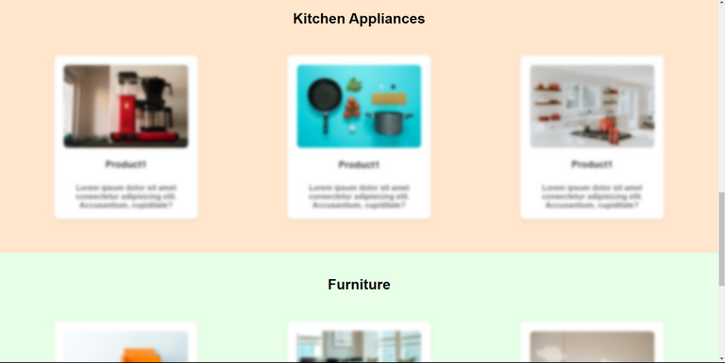
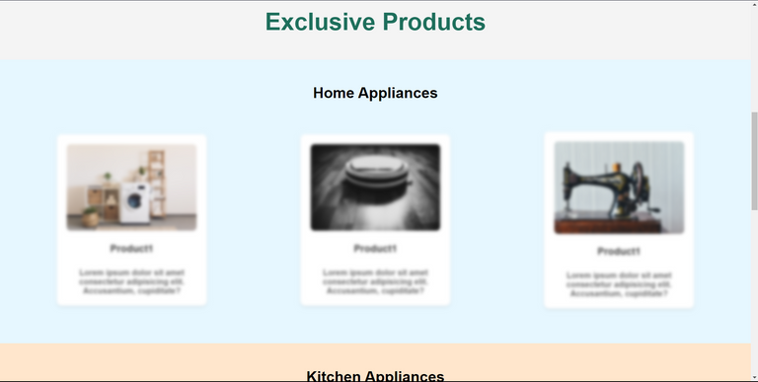
CHRIST
Deemed to be University
HOME PAGE WHEN THE USER IS NOT LOGGED IN
Simple UI
Features are not accesible
User login is necessary to access features
Features are Blured
Option to login or sign up
Excellence and Service

Slide 16

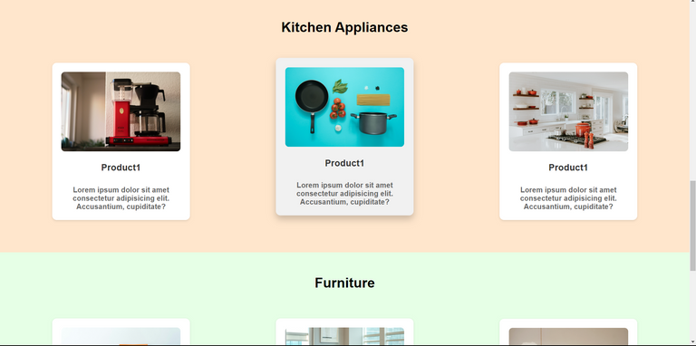
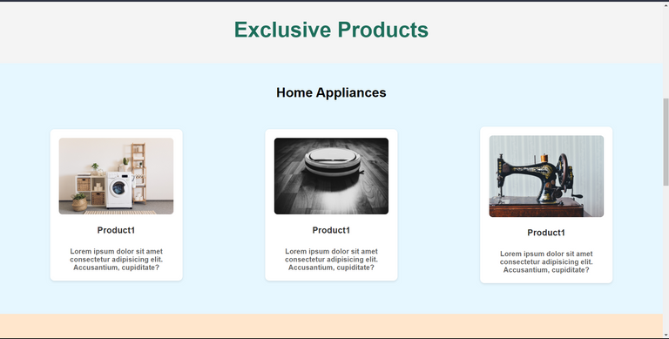
CHRIST
Deemed to be University
HOME PAGE WHEN THE USER IS LOGGED IN
Simple UI
Easy to use
Minimalistic
Interesting
3 Exclusive products in each category
Excellence and Service

Slide 17
CHRIST
Deemed to be University
PRODUCT MANAGEMENT
Excellence and Service

Slide 18


CHRIST
Deemed to be University
CATEGORIES
Browse through available categories
Available Categories:Home Appliances, Furniture, Kitchen Appliances
Each category links to a different page, with related products
Category page contains: Product listings, Image and Price.
Excellence and Service

Slide 19
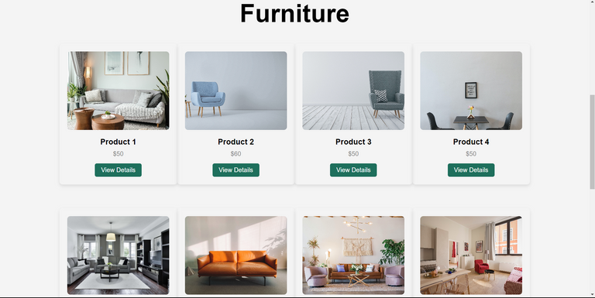
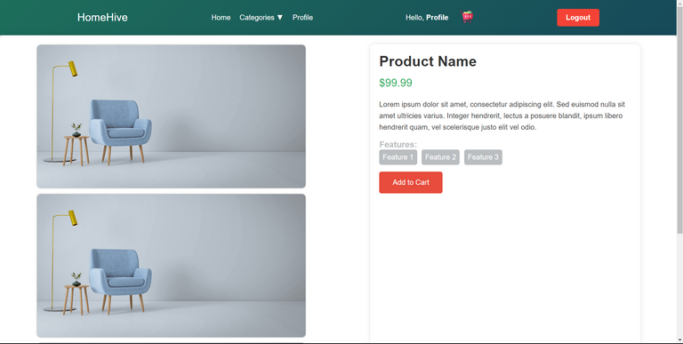
CHRIST
Deemed to be University
PRODUCTS
PRODUCT LISTINGS
PRODUCT PAGE
Variety of Products
Browse through Products
Product Name
Product Details
Features
Price
Add To Cart
Quantity
Excellence and Service

Slide 20
CHRIST
Deemed to be University
PROFILE MODULE
Excellence and Service

Slide 21
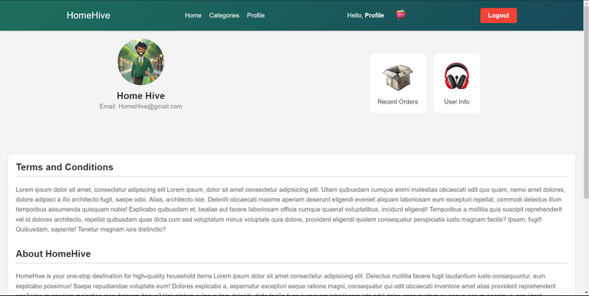
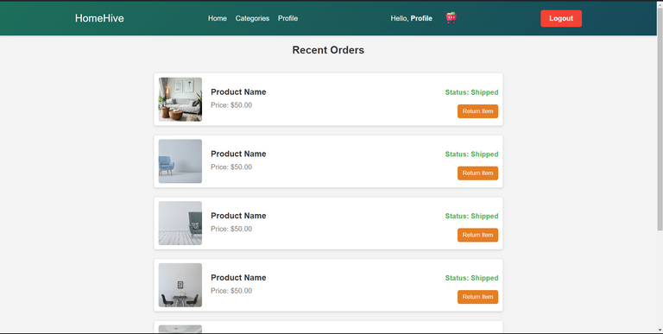
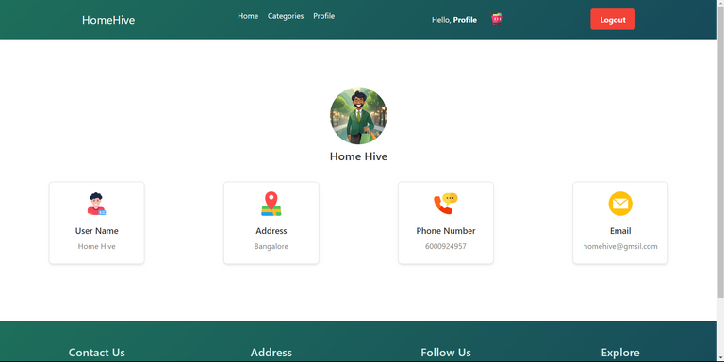
CHRIST
Deemed to be University
PROFILE AND SUB-PROFILE
PROFILE
RECENT ORDERS
Products, Date ordered, Return option.
CONTACT US
Contains contact information
HomeHive email
Phone number
Excellence and Service

Slide 22
CHRIST
Deemed to be University
SHOPPING CART AND ORDER PROCESSING
Excellence and Service

Slide 23
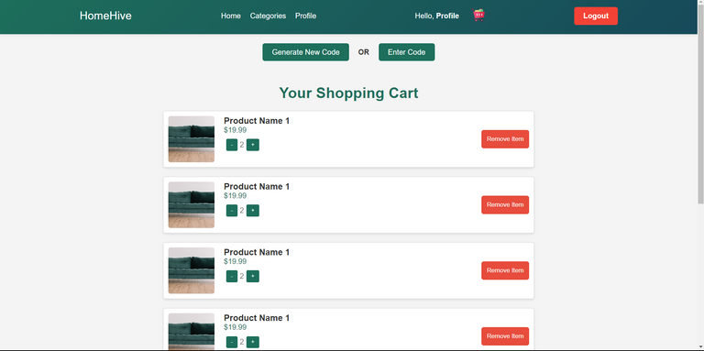
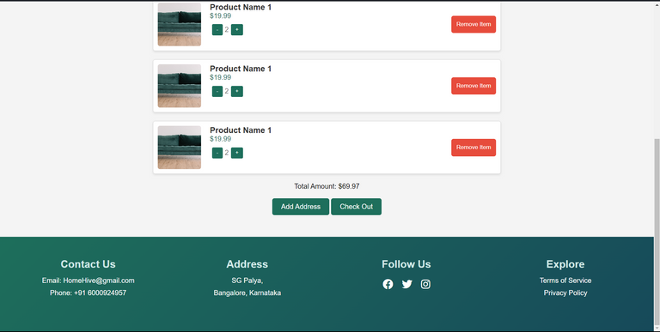
CHRIST
Deemed to be University
SHOPPING CART
SHOPPING CART
Generate Code
Enter Code
List of products
Add Address
Checkout
Excellence and Service

Slide 24
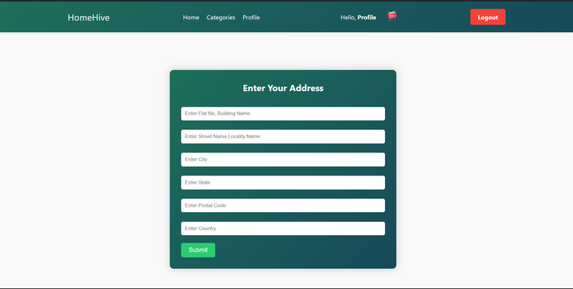
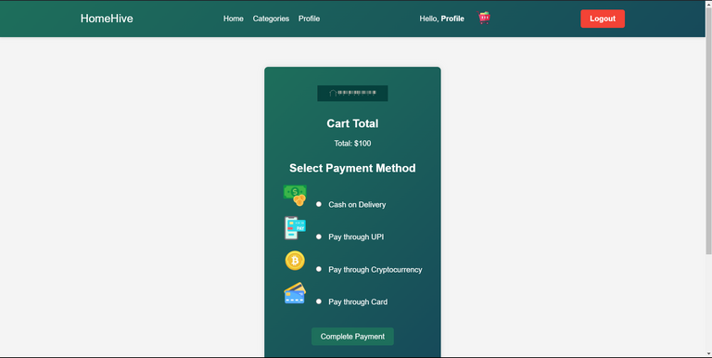
CHRIST
Deemed to be University
ORDER
ADD ADDRESS
PAYMENT MODE
Address line 1
Address line 2
City
State
Postal Code
Country
Cart Total
Cash on Delivery
UPI
Cryptocurrency
Cards
Excellence and Service

Slide 25
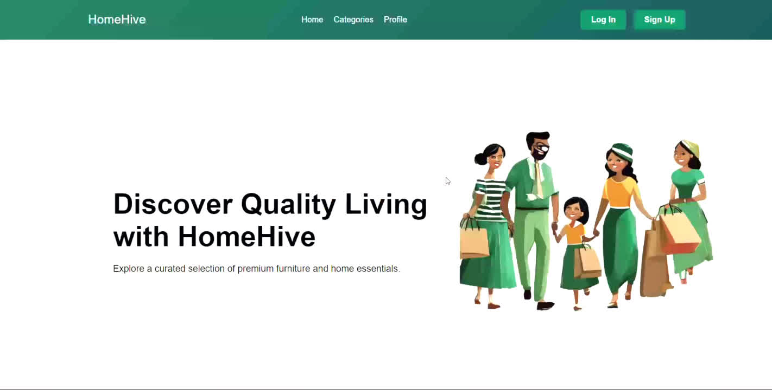
CHRIST
Deemed to be University
HOW TO PLACE AN ORDER
Excellence and Service

Slide 26
CHRIST
Deemed to be University
DATABASE
Excellence and Service

Slide 27
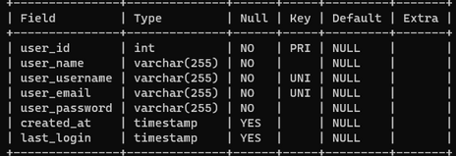
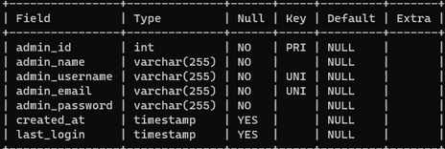
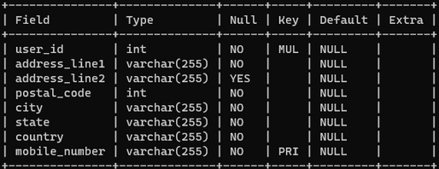
CHRIST
Deemed to be University
DATABASE
USER LOGIN
ADMIN LOGIN
USER ADDRESS
Excellence and Service

Slide 28
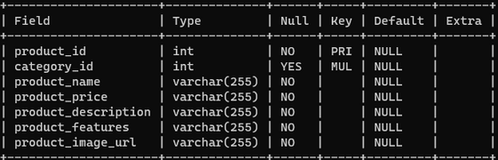
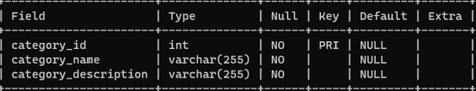
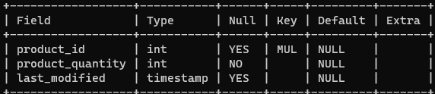
CHRIST
Deemed to be University
DATABASE
PRODUCT
PRODUCT CATEGORY
PRODUCT INVETORY
Excellence and Service

Slide 29
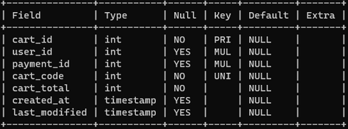
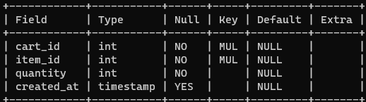
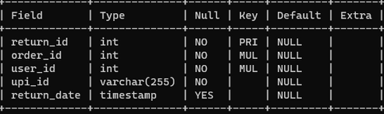
CHRIST
Deemed to be University
DATABASE
CART
CART ITEMS
RETURN
Excellence and Service

Slide 30
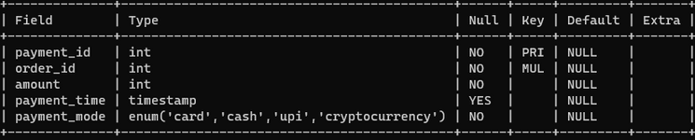
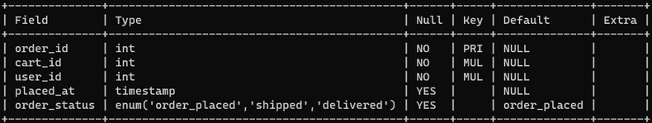
CHRIST
Deemed to be University
DATABASE
PAYMENT
ORDER
Excellence and Service

Slide 31
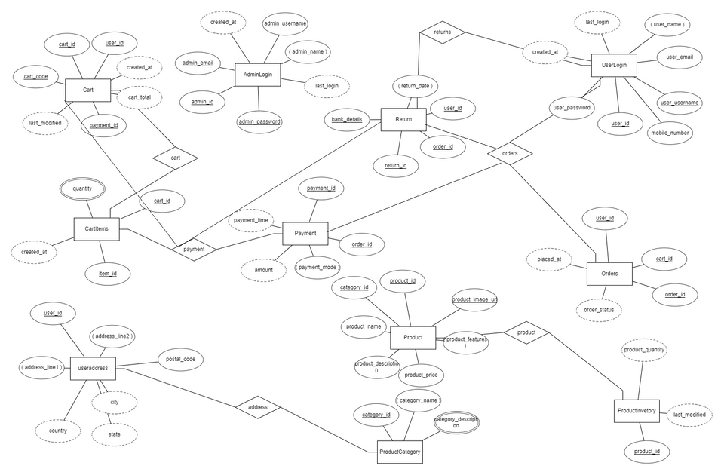
CHRIST
Deemed to be University
ENTITY-RELATION DIAGRAM
Excellence and Service

Slide 32
CHRIST
Deemed to be University
THANK YOU
Excellence and Service

Slide 33

CHRIST
Deemed to be University
TIMELINE
WEEK 1- WEEK 2
WEEK 3-WEEK 6
WEEK 7-WEEK 10
WEEK 11-END
SYSNOPSIS AND
SRS SUBMISSION
UI
CREATION
DATABASE CREATION
CONNECTIVITY
Excellence and Service

